Slide 1
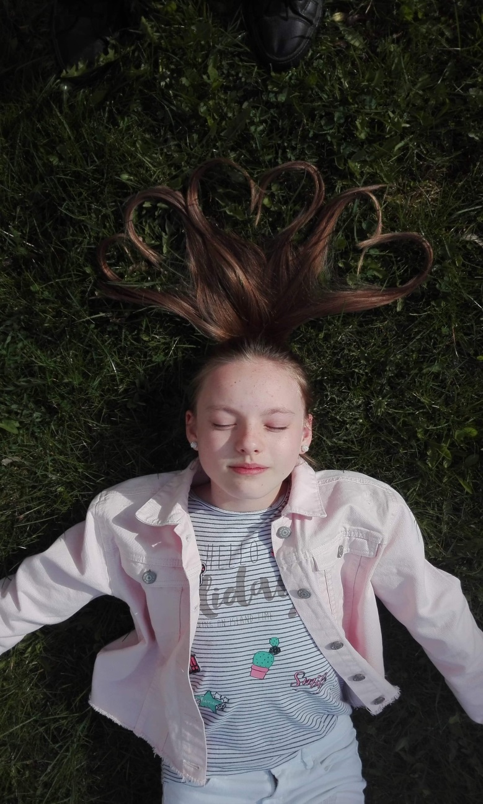
MY DAY

Slide 2
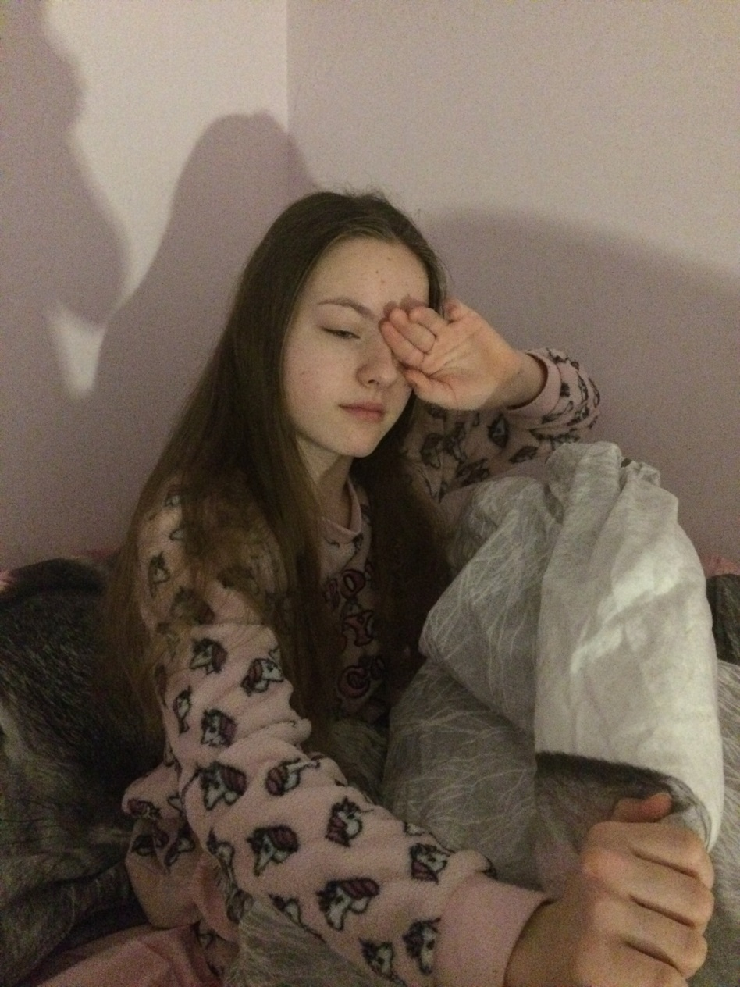
I wake up at six o’clock.

Slide 3
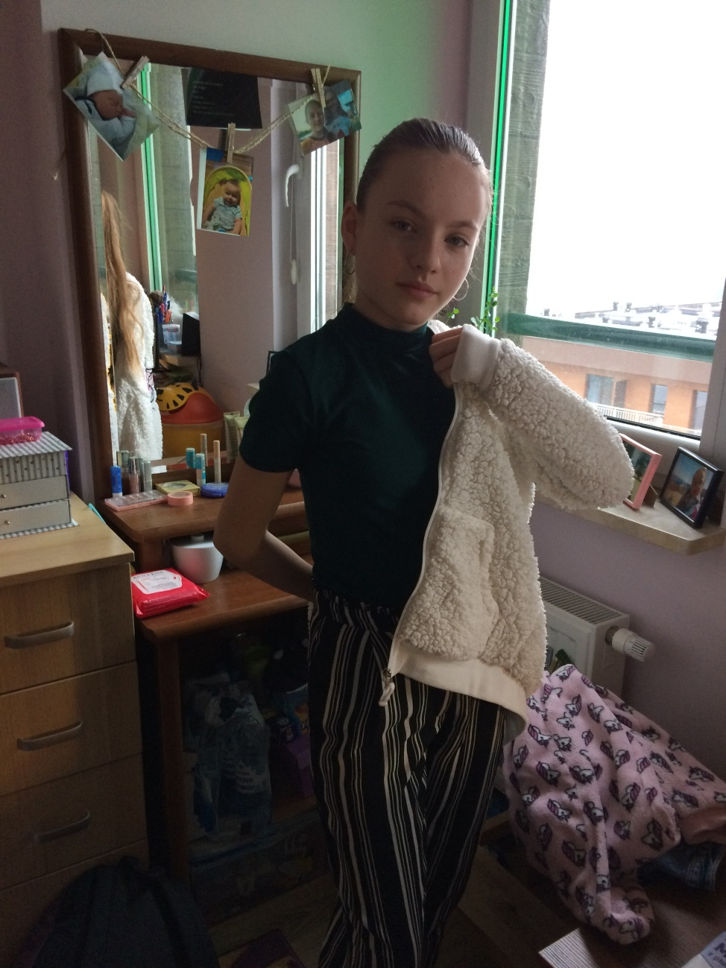
I change my clothes at quarter past six.

Slide 4
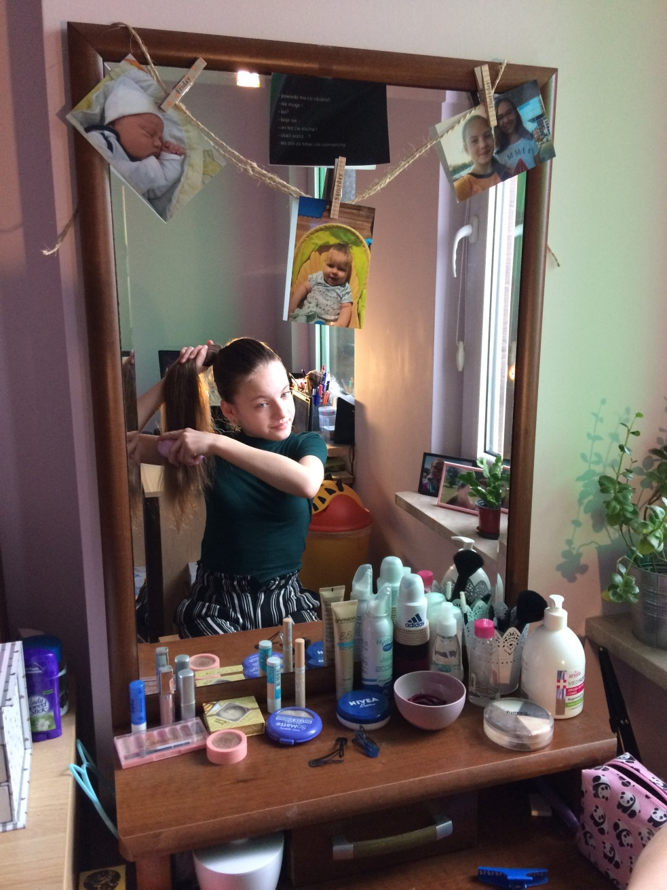
I brush my hair at twenty past six.

Slide 5
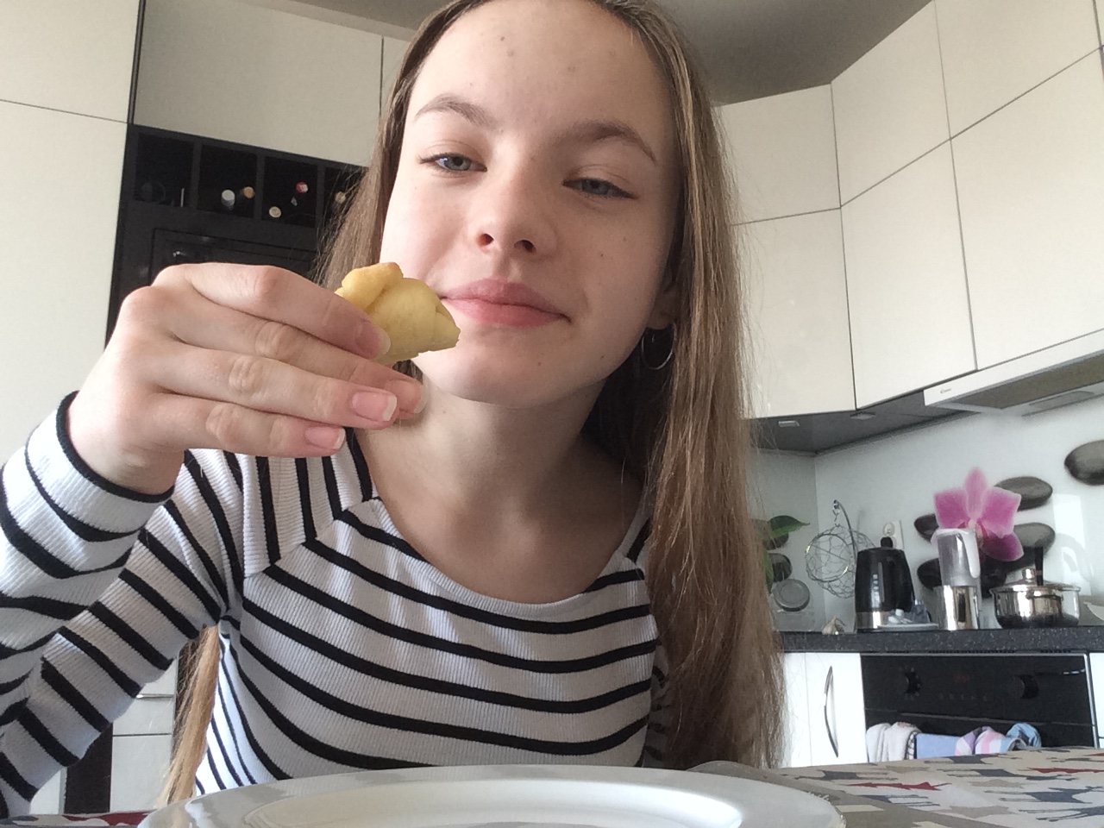
I eat my breakfest at twenty five past six.

Slide 6
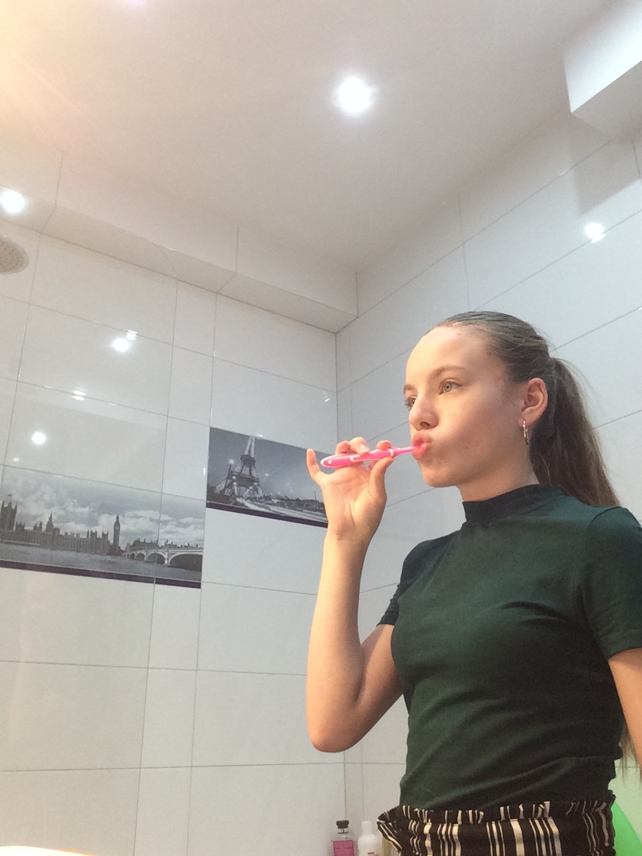
I brush my teath at ten to seven.

Slide 7
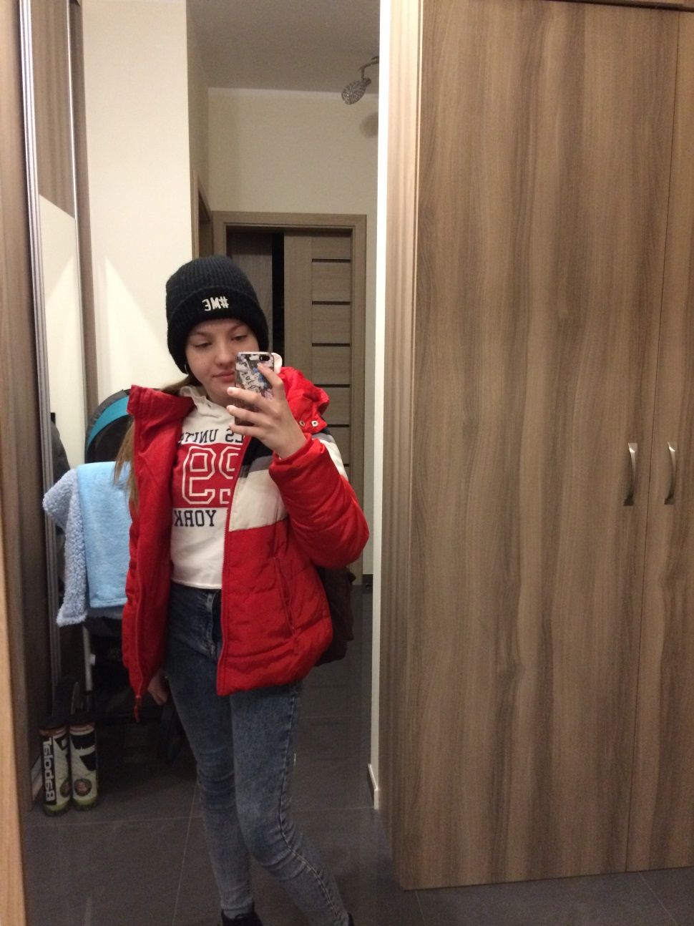
I go to school at ten past seven.

Slide 8
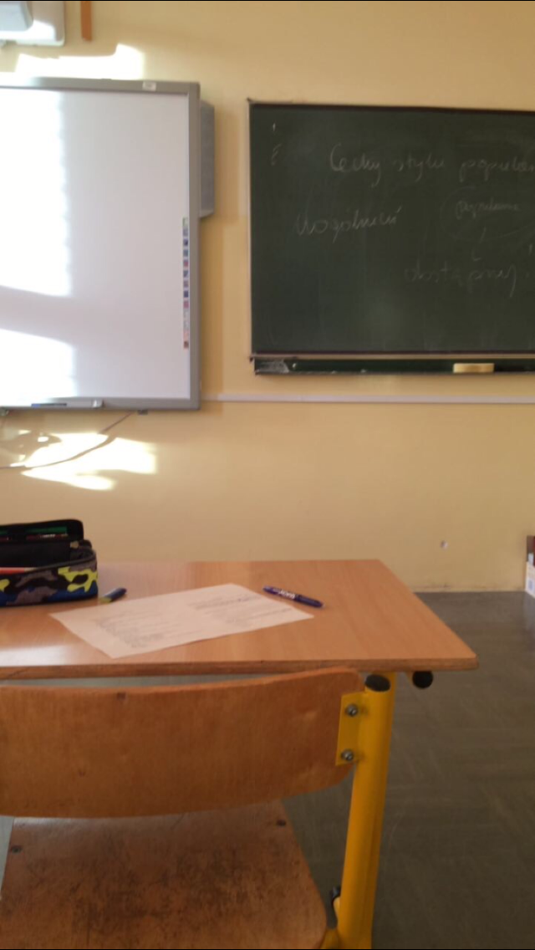
I start lessons at eight o’clock.

Slide 9
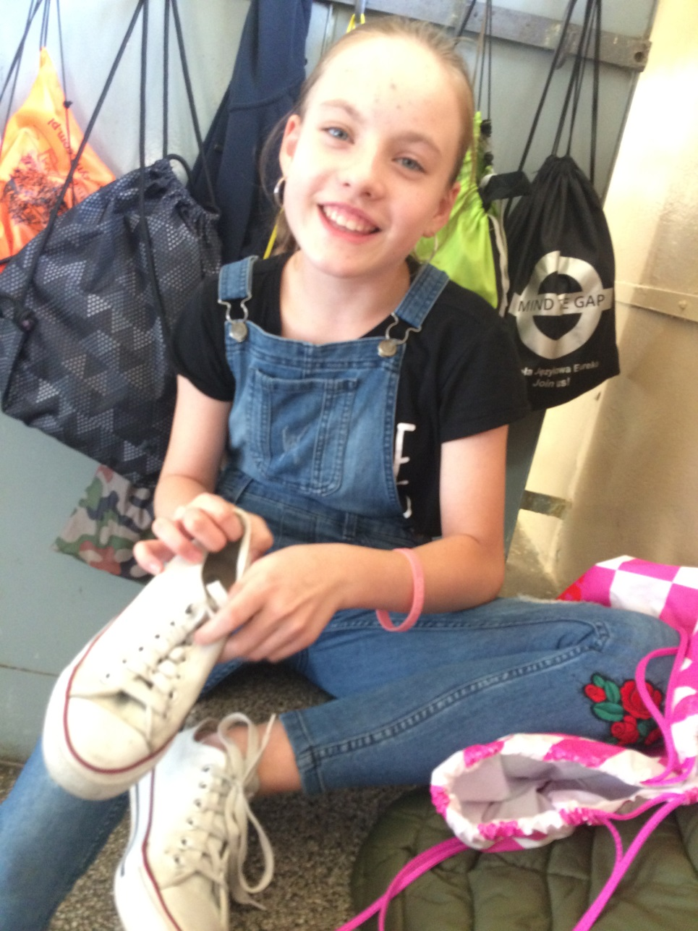
I finish lessons at half past twelve.

Slide 10
I eat dinner at quarter to one.

Slide 11
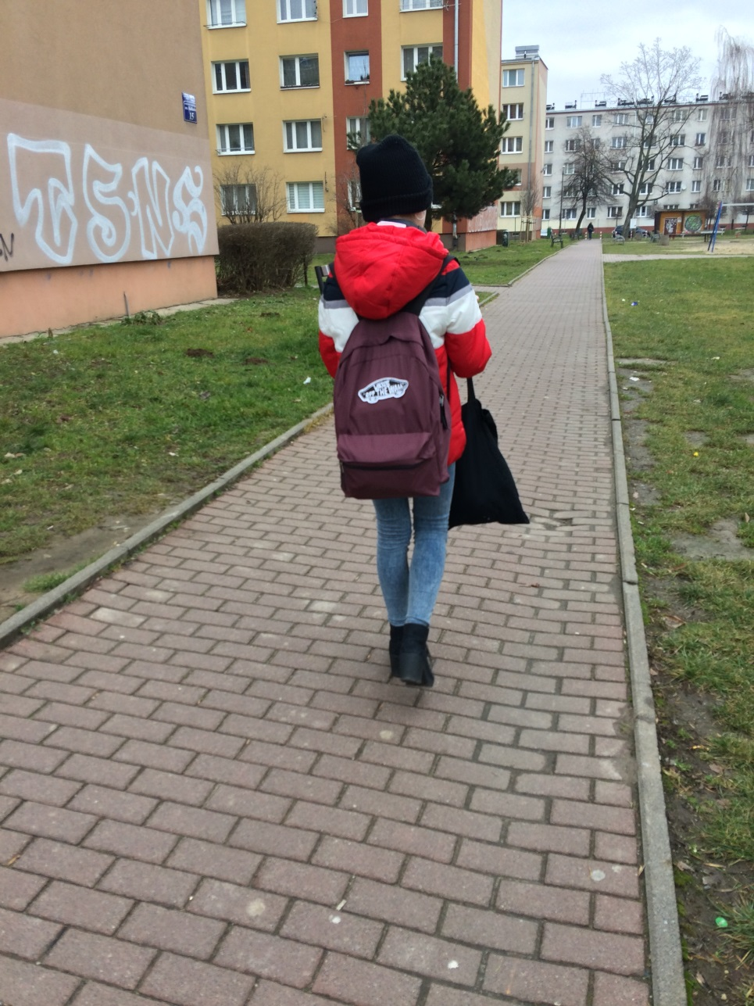
I back home at one o’clock.

Slide 12
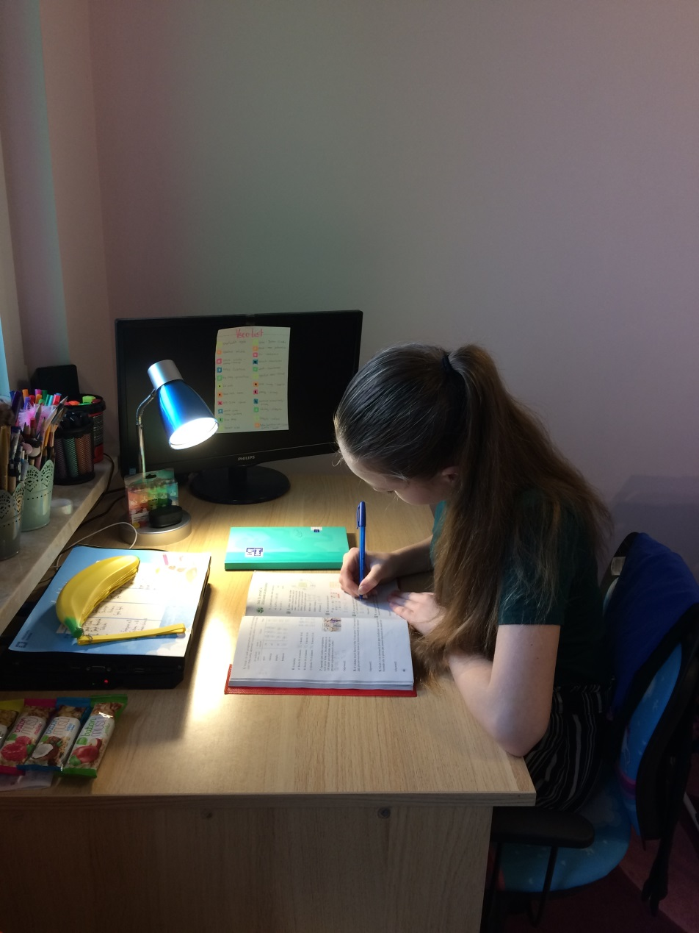
I do my homework from half past one to two.

Slide 13
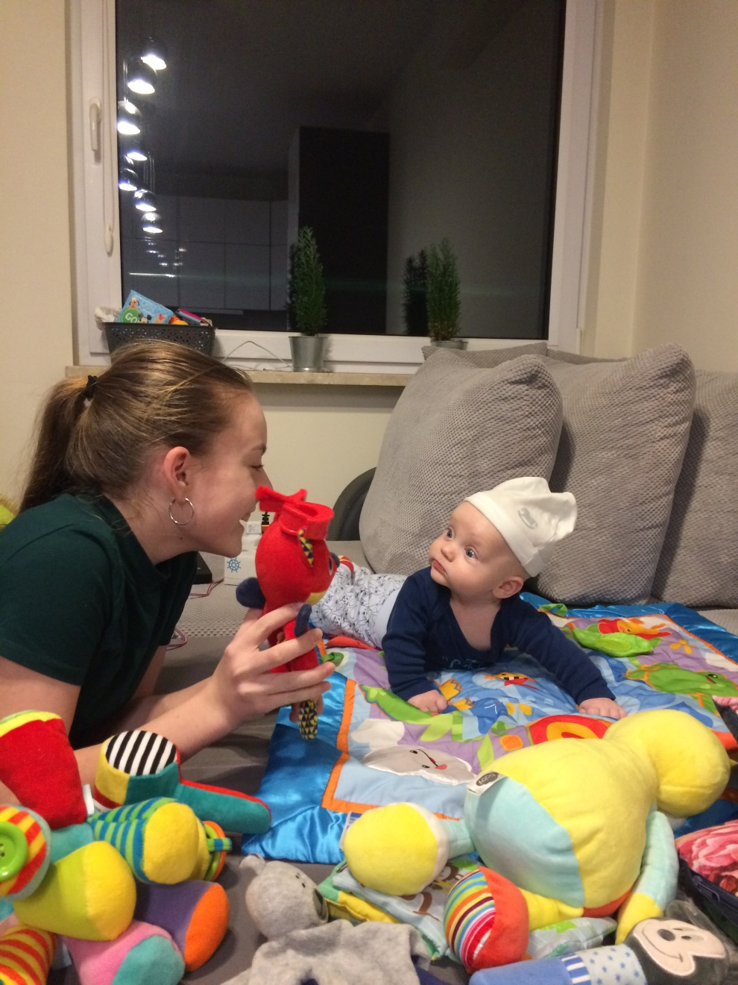
I play with my brother at two o’clock.

Slide 14
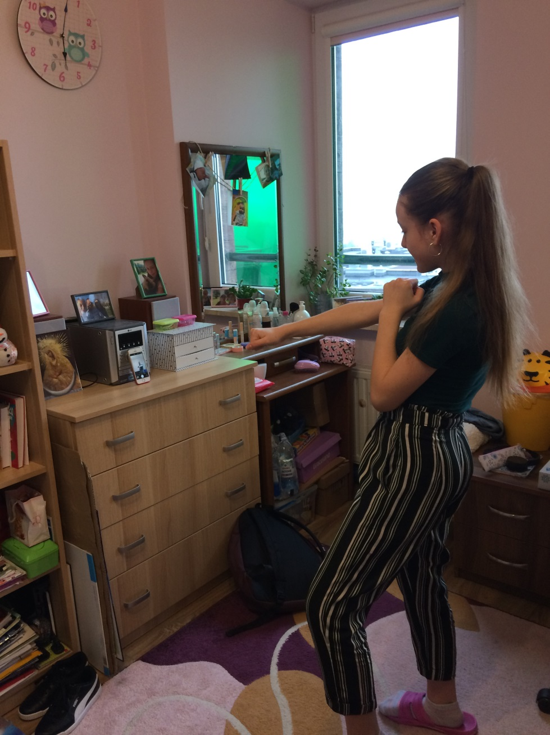
I record tiktok films at half past two.

Slide 15
On half past three I go to extra lesson of English.

Slide 16
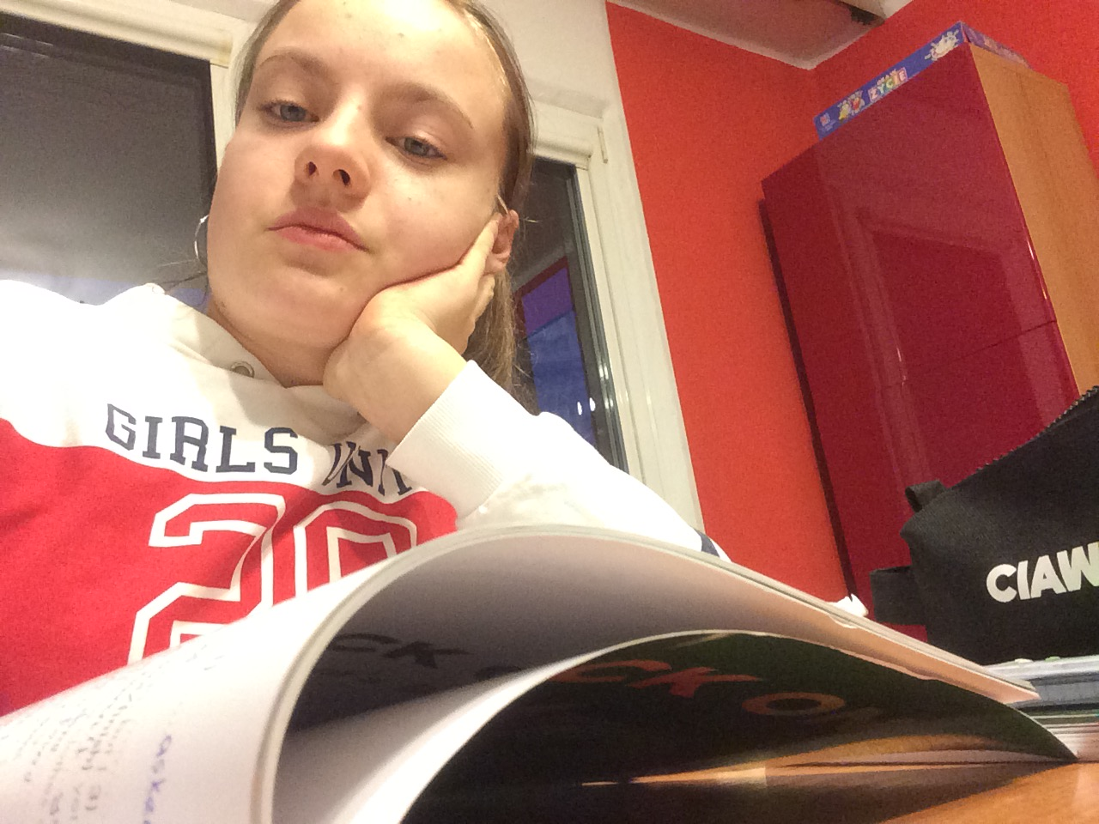
After English I go to music school.

Slide 17
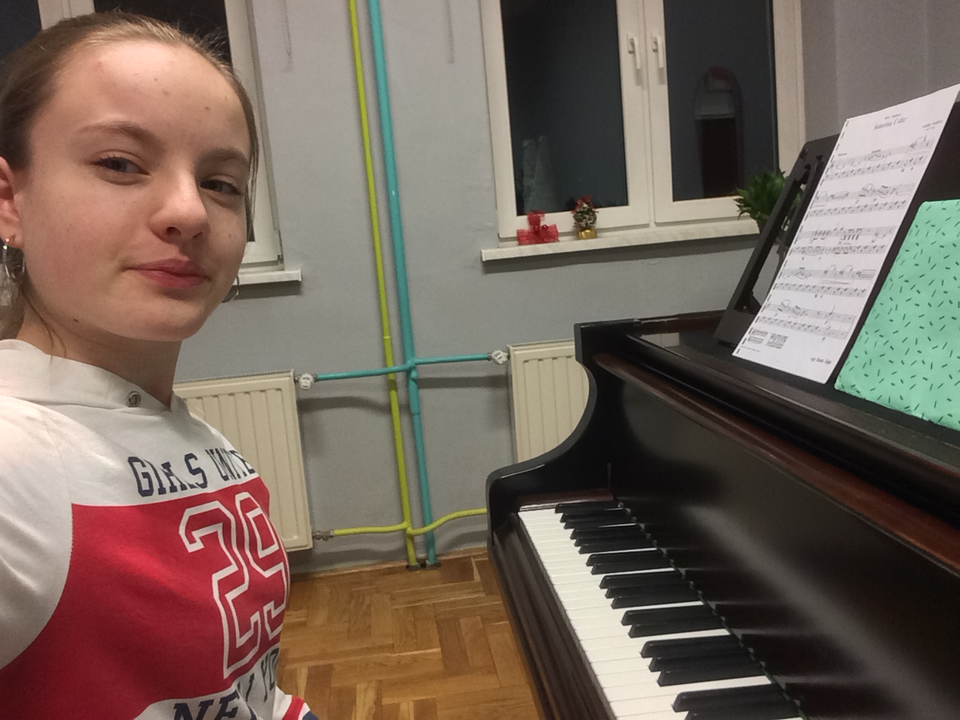
At five o’clock I have the piano.

Slide 18
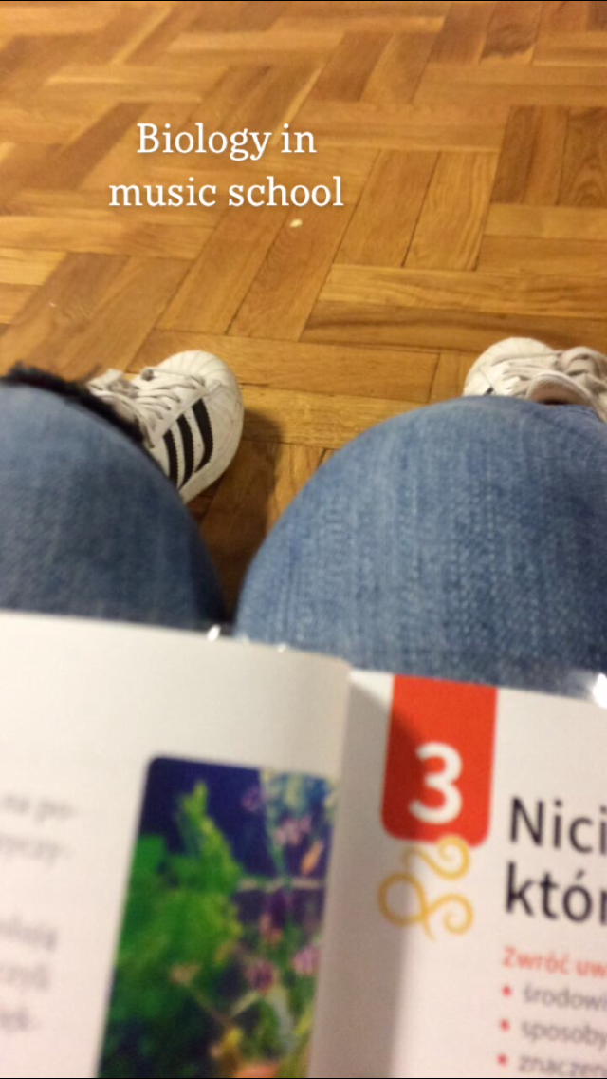
After the piano, I wait for the guitar seventy minutes.

Slide 19
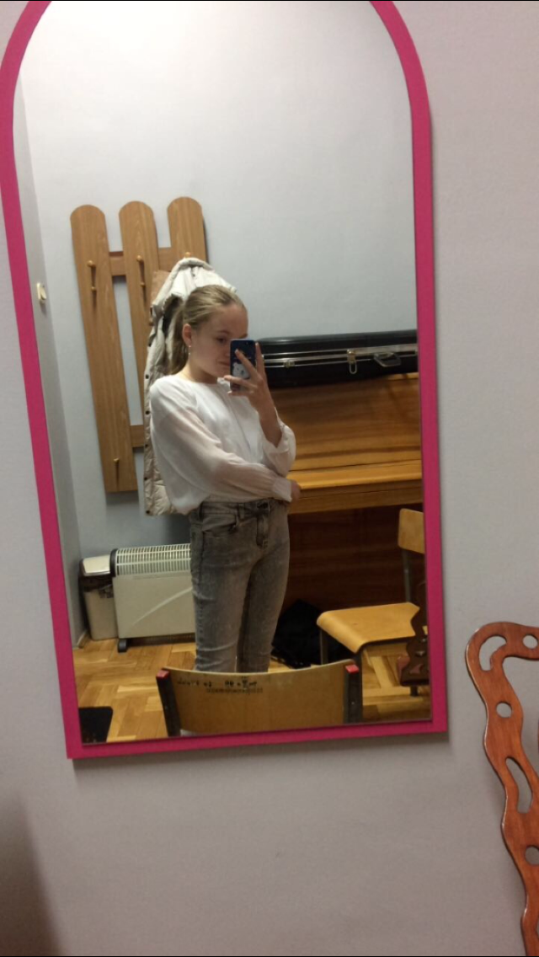
My guitar lesson starts at quarter to nine.

Slide 20
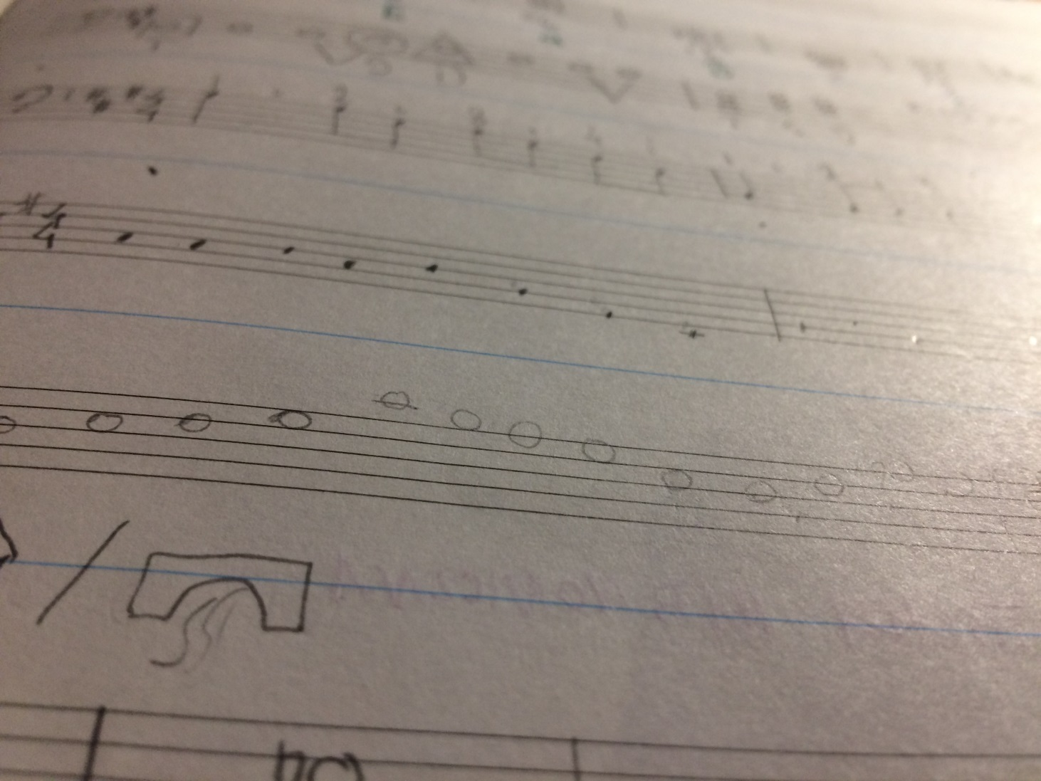
I have music lesson from half past seven to quarter past eight.

Slide 21
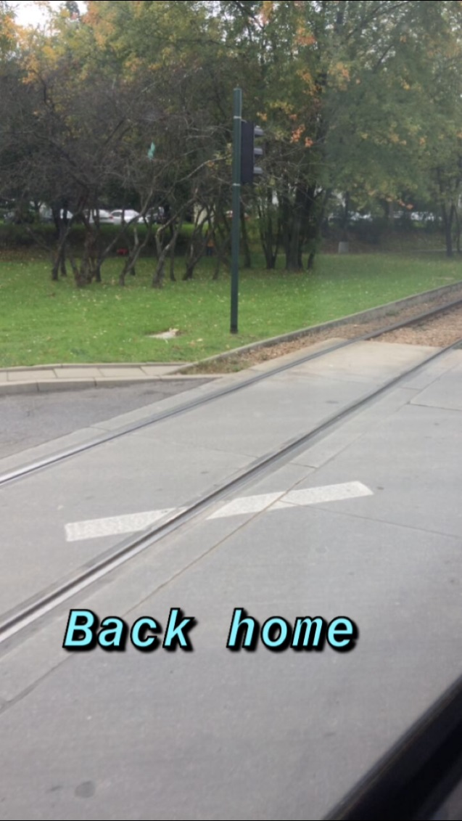
I back home at half past eight.

Slide 22
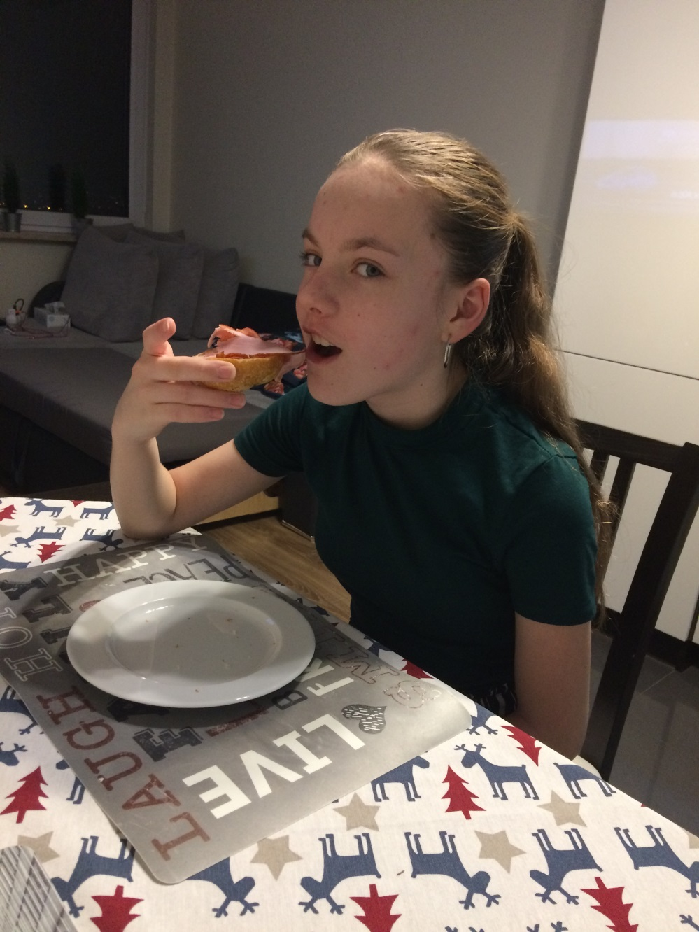
I eat supper at nine o’clock.

Slide 23
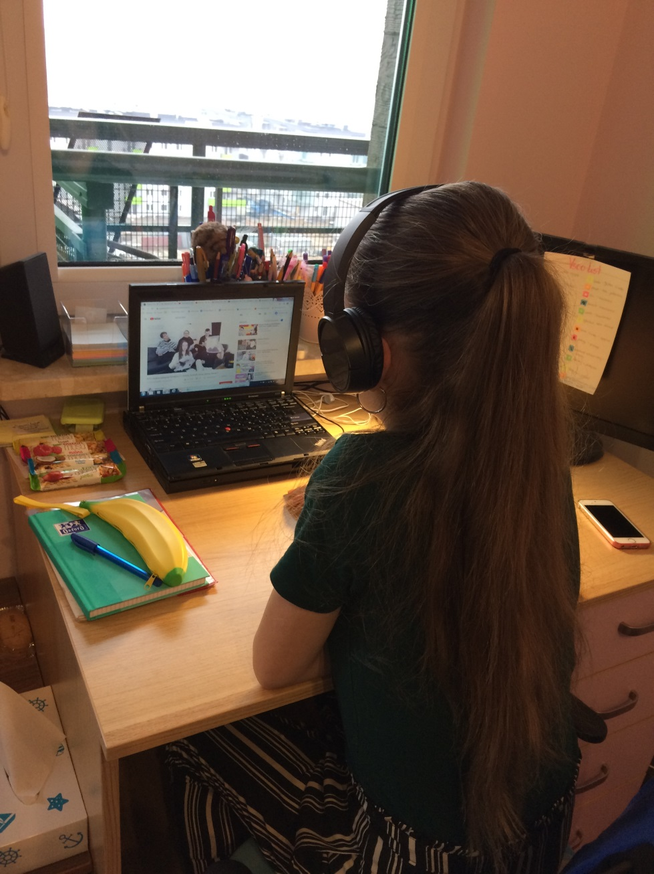
I watch youtube at half past nine.

Slide 24
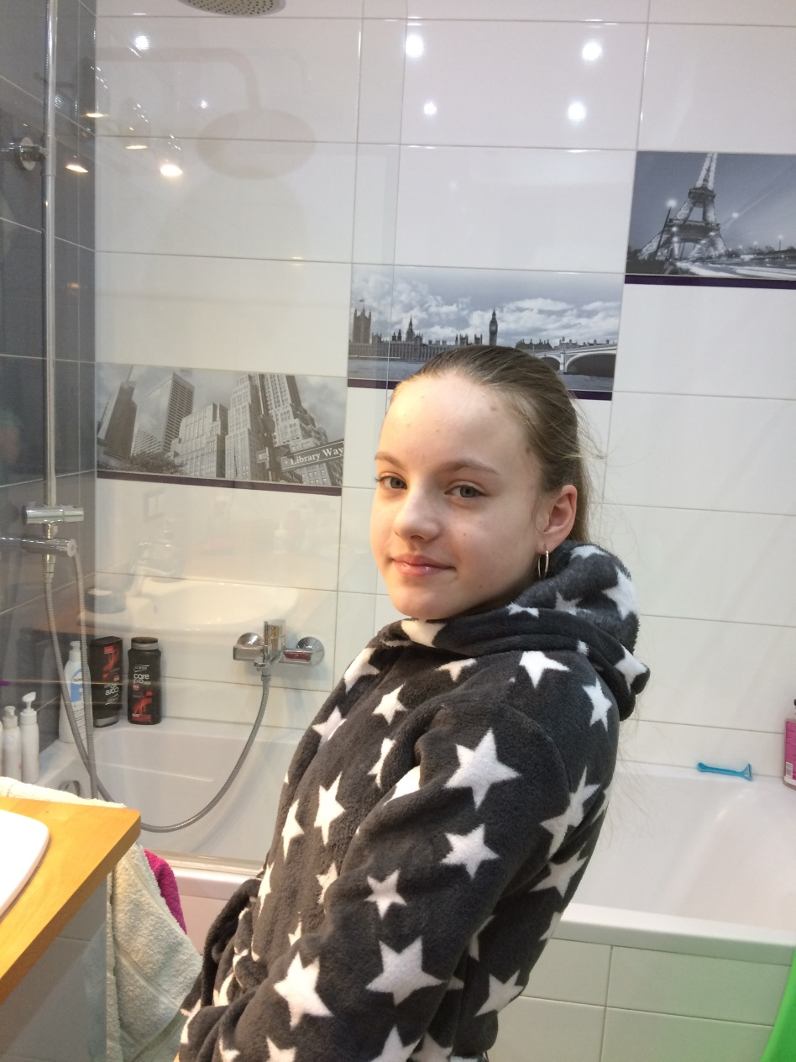
I take a shower at ten o’clock.

Slide 25
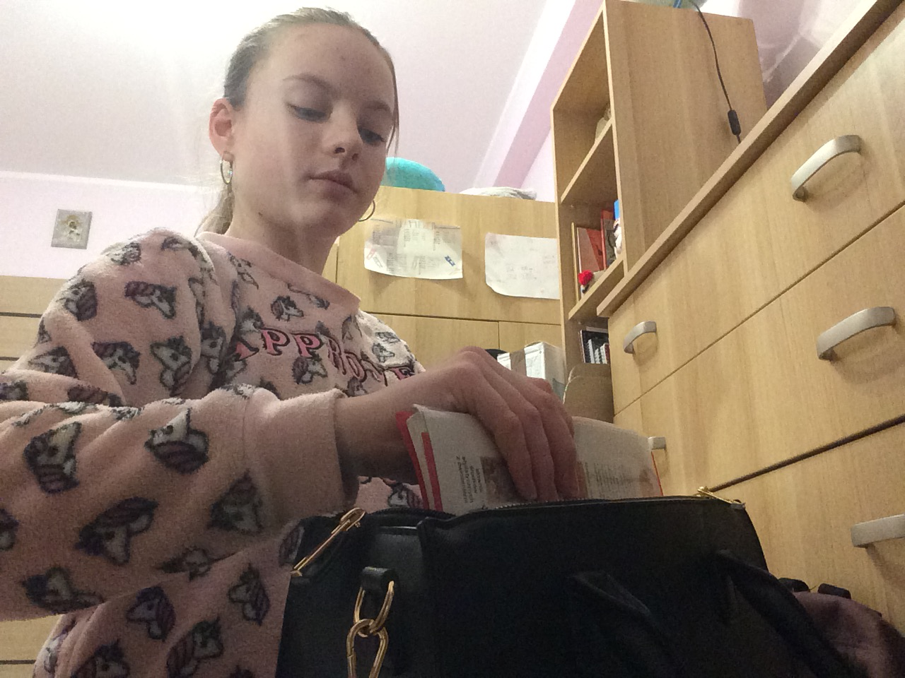
I prepare to school for the next day at half past ten.

Slide 26
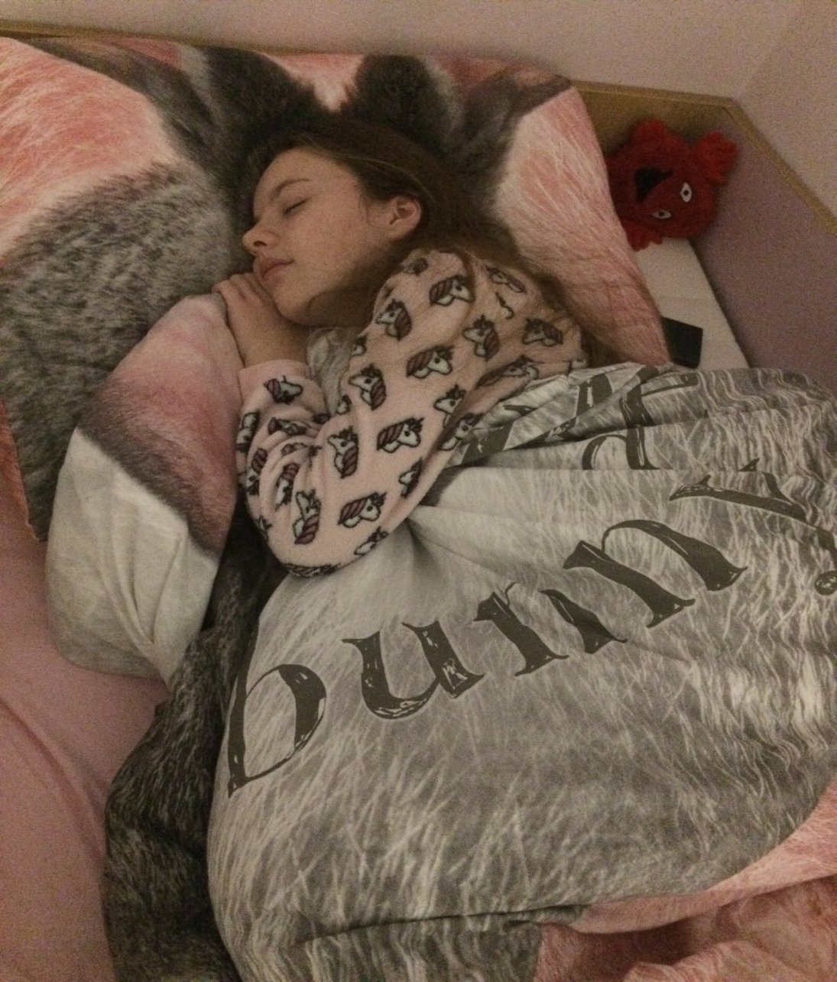
I go to bed at eleven.

